Slide 1

Managing a Portfolio During a Recession
New Canaan Men’s Club
Presentation by: Paul A. Strassmann, Investment Club

Slide 2
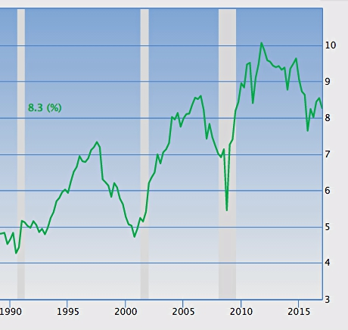
Corporate Profit Margins Are a Recession Indicator
Corporate Profit Margins - %
http://www.multpl.com/s-p-500-earnings-yield/table/by-year

Slide 3
Why are Corporate Profit Margins Recession Indicators?
Earnings/Investments are the drivers of the stock market.
When corporate profit margins decline to about 5% a recession occurs.
Afterwards the Federal Reserve restores recessions to a prior peak.

Slide 4
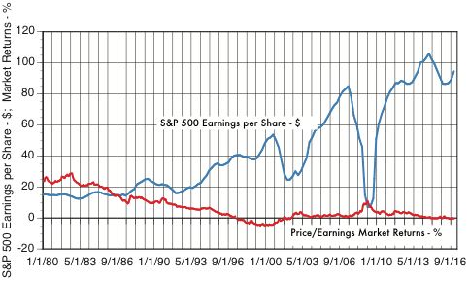
As Price/Earnings Rise, S&P 500 Share Earnings Plunge
https://www.gurufocus.com/economic_indicators/94/shiller-pe-implied-market-return#94+58

Slide 5
Why are Increases in Price/Earnings a Recession Indicator?
In 2000 and in 2007 a rise in Price/Earnings % precipitated recessions.
2017 to 2018 S&P 500 drop could result in a large recession.

Slide 6
Rules for Managing a Portfolio During a Recession
Comply with Warren Buffet rules.
Adopt Peter Lynch choices.
Realize High Altman Z-Scores
Achieve High Piotrovsky F-Ratings
Pass Beneish M-Score

Slide 7
Warrant Buffett Portfolio Rules
Choose widely diversified investments.
Pick shares with a durable competitive advantage.
Invest in firms with low capital requirements
Select firms with high investment returns.
Invest in firms with long-term growth.

Slide 8
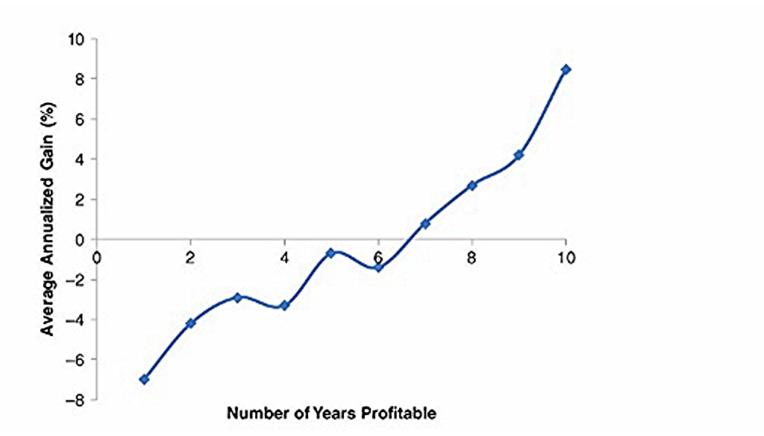

Warren Buffet Selects Shares Profitable for More than Nine Years
From C.Tiani, Invest Like a Guru, Wiley

Slide 9
Peter Lynch Rules
Show steady earnings and earnings growth.
Deliver high earnings relative to high margins of safety.
Pick firms with low or no debt.

Slide 10
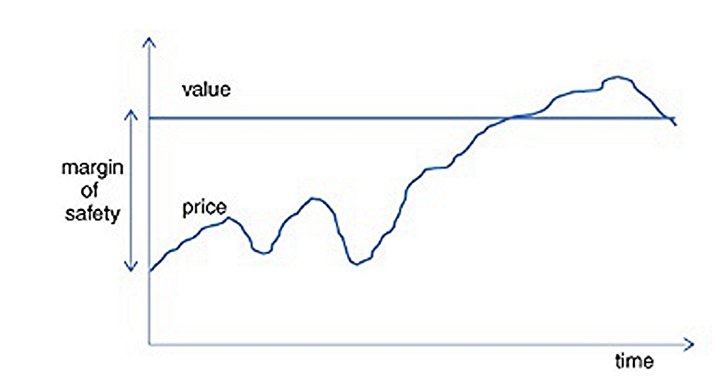
Peter Lynch Selects Firms with High Margins of Safety
From C.Tiani, Invest Like a Guru, Wiley

Slide 11
A Checklist for Making a Good Investment
✅ Meets Warrant Buffett criteria.
✅ Meets Peter Lynch criteria.
✅ Show at least 7 years of profits.
✅ Profitable through business cycle.
✅ Less than 30% of cash flow applied to capital expenses.
✅ Return on Equity greater than 15%.

Slide 12
Investment Types
❌ Do not invest in slow growers.
✅ Profitable and predictable companies.
- Picked by trading investors, or
- Dividend investors.
❌ Do not invest in rapid growth startups.

Slide 13
Investment Types
❌ Do not invest in asset plays.
❌ Do not invest in turnarounds.
❌ Do not invest in cyclical firms.

Slide 14
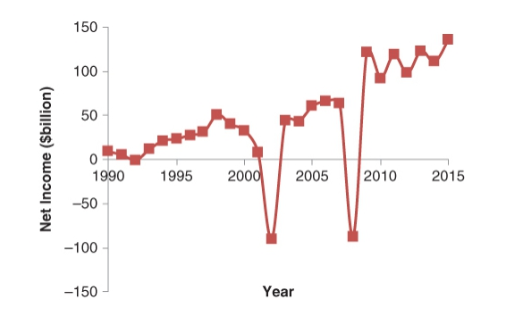
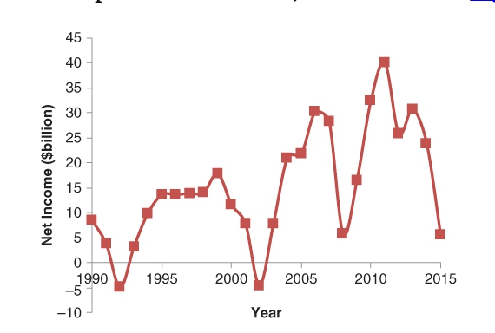
Avoid Cyclical Companies
Consumer Cyclical Net Income
Basic Materials Net Income
From C.Tiani, Invest Like a Guru, Wiley

Slide 15
Determine and Then Concentrate on Intrinsic Values
The intrinsic value of a share equals the discounted cash flow generated during remaining life.
Do not diversify to reduce risks.
Excess diversification is protection against ignorance.
Always understand how business operations are conducted.

Slide 16
Buy Stable Businesses
Avoid cyclical companies.
Invest in firms that have brief repurchase cycles.
Buy firms that have long product cycles, bought for cash.
Purchase firms with low capital requirements for growth.

Slide 17
Invest in Companies With Good Management
Management will reinvest cash back into business growth.
Excess cash is used for acquisitions if profit criteria are met.
Stocks are bought back if surplus cash has no other use.
Purchase only firms with low capital requirements for growth.
Debt will be always reduced.
Dividends will be always increased.

Slide 18
Policies for Managing Recessions
Buy when a recession is at the bottom.
Greatest returns are realized during recovery from recession.
Maintain high cash positions when recession peaks.
Rate of profit during recovery from recession should exceed 20%.
Buy $1 bills for less than 50 cents.

Slide 19
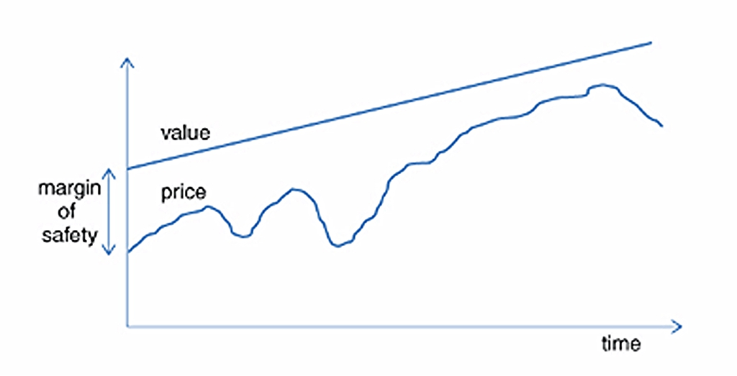
Trading of Shares During Business Cycle
From C.Tiani, Invest Like a Guru, Wiley

Slide 20
Test All New Investments Against Altman Z-Scores
The Z-score equation predicts the probability that a firm will go into bankruptcy within two years.
Variables:
X₁ = working capital / total assets.
X₂ = retained earnings / total asset
X₃ = earnings before interest and taxes / total assets.
X₄ = market value of equity / book value of total liabilities.
X₅ = sales / total assets.
Z > 2.99 - Safe; 1.81 < Z < 2.99 - Vulnerable; Z < 1.81- Bankruptcy.

Slide 21
Test All New Investments Against Piotrovsky F-Scores
Piotrovski developed a point scoring method for scoring the characteristics of companies.
Companies that scored high (8 or 9) on a F-Score outperformed the average S&P 500 index.
The F-scoring method covers:
Change in Return on Assets; Quality of Earnings; Change in Leverage;
Change in Working Capital; Return on Assets (ROA);
Cash Flow Return on Assets; Change in Shares in Issue;
Change in Gross Margin; Change in asset turnover.

Slide 22
Test All New Investments Against Beneish M-Score Ratings
M-Score of less than -2.22 suggests that the company is not an accounting manipulator.
M-Score of greater than -2.22 signals that the company is likely an accounting manipulator.
The evaluation method includes:
Days Sales in Receivables; Gross Margin; Asset Quality;
Sales Growth; Depreciation; Sales, General and Administrative expenses; Leverage; Total Accruals to Total Assets.

Slide 23
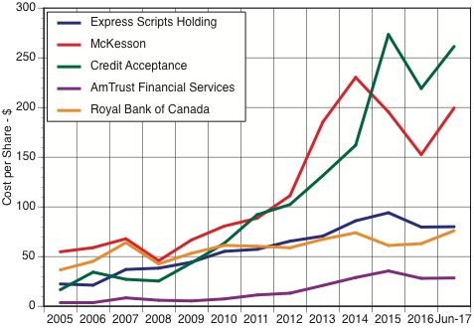
A View of Undervalued Companies
From C.Tiani, Invest Like a Guru, Wiley

Slide 24
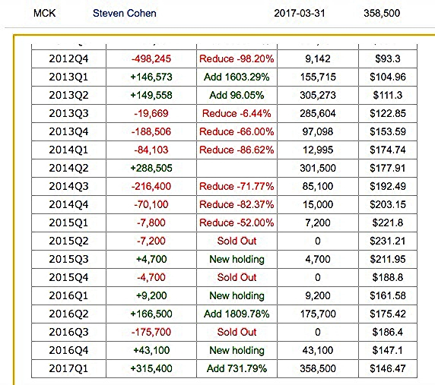
Example of Trading for Profit for McKesson Company (MCK)
From C.Tiani, Invest Like a Guru, Wiley

Slide 25
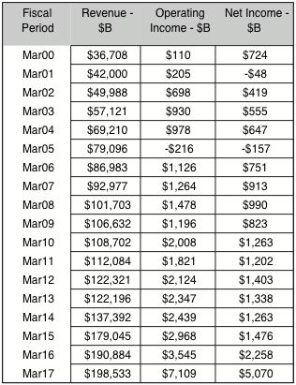
Example of Growth and Income of McKesson Company (MCK)
From C.Tiani, Invest Like a Guru, Wiley

Slide 26
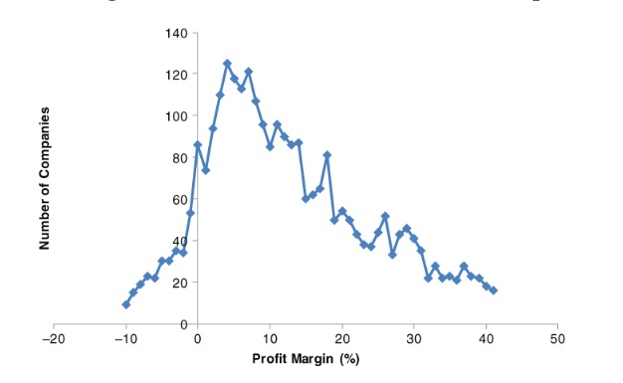
Invest in High Profit Margin Companies (Chart for 3,577 Firms)
S
Superior Firms
From C.Tiani, Invest Like a Guru, Wiley

Slide 27
Comments on McKesson Company
Stock market gains realized as business cycle is ending.
Hedge fund trading shows large gains in business cycle.
Long-term revenue and profit gains show a good investment.
Invest in MCK when price makes profit margins attractive.
12% of companies had operating margins >20% for 10 years

Slide 28
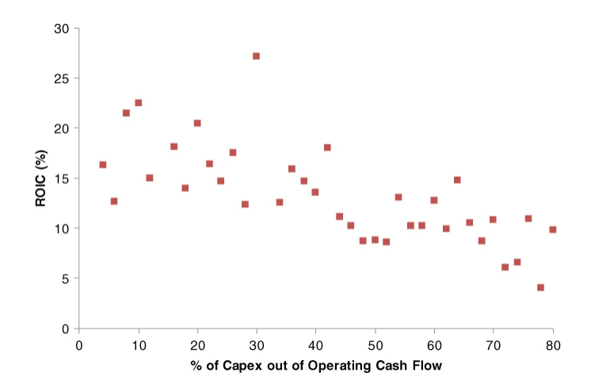
Return on Invested Capital Declines with Higher Assets
From C.Tiani, Invest Like a Guru, Wiley

Slide 29
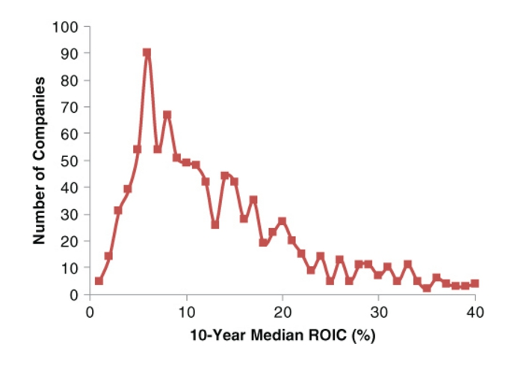
Few Companies Have Long Term Return on Capital >20%
From C.Tiani, Invest Like a Guru, Wiley

Slide 30
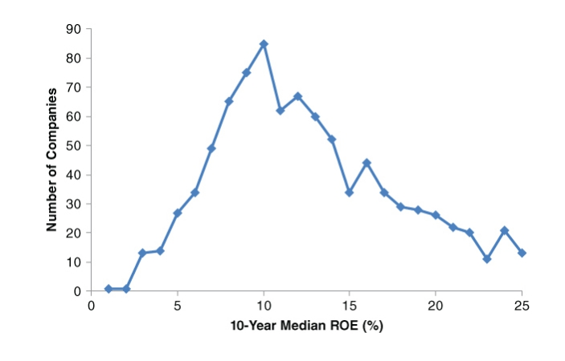
Few Companies Have a Return on Equity (ROE) Over 20%
From C.Tiani, Invest Like a Guru, Wiley

Slide 31
Capital Intensity Depresses Investment Returns
Return on Invested Capital (ROIC) declines from 20% to less than 10% as the % of Invested Capital flow rises to over 80%.
Only 209 companies out of 1,045 have achieved ROIC over 20%.
Very few companies have a Return on Equity over 20%,

Slide 32
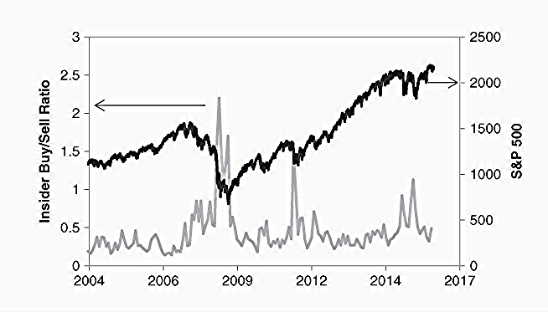
Insiders Buy Shares As Market Declines
https://fred.stlouisfed.org

Slide 33
Insiders Puchase Shares in a Down Market, Sell as Market Rises
The insider Buy/Sell ratio is a good indicator of a business cycle.
As business cycle ages, investors should anticipate next decline.

Slide 34
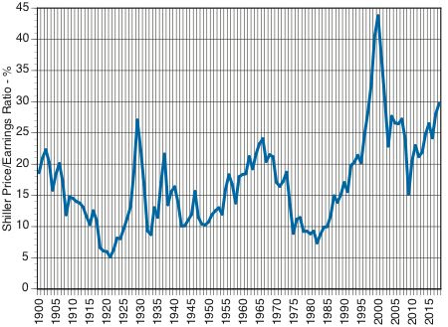
Shiller P/E – A Better Measurement of Market Valuation
From C.Tiani, Invest Like a Guru, Wiley

Slide 35
Investors Should Anticipate Negative Returns
Schiller P/E measures market's valuation.
With current P/E levels future market returns could be -1.9% a year.

Slide 36
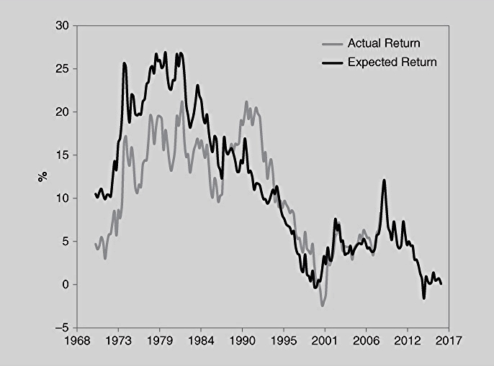
Profit Returns from Investments in US Have Declined
From C.Tiani, Invest Like a Guru, Wiley

Slide 37
Investors Should not Anticipate Past Returns
Annual returns of Wilshire 5000 Full Cap prices have declined.
The US stock market valuations are now in an overall down cycle.
Future market do not look promising.

Slide 38
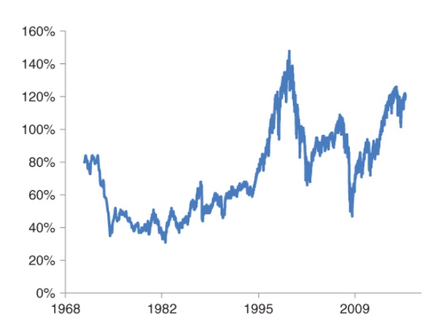
Total Market Capitalization/GDPIncreased with Low Interest Rates
From C.Tiani, Invest Like a Guru, Wiley

Slide 39
Total Market Capitalization/GDP Stimulated by Low Interest Rates
Wilshire 5000 Full Cap prices boosted by low cost of capital.
Pending increases in interest rates will depress stock prices.
Forecast of future market prices do not look promising.

Slide 40
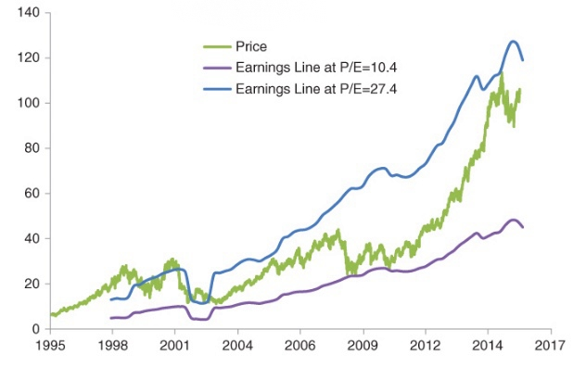
For Traders: Buy in 2008, Sell in 2015
From C.Tiani, Invest Like a Guru, Wiley

Slide 41
P/E Valuations for Making Trading Decisions
Buy for low P/E values in 2001 to 2004, and 2007 to 2011.
Sell for high P/E values in 2006 to 2008, and 2013 to 2015.

Slide 42
Conclusions
Investment in poor companies results in permanent loss of capital.
Make investment choices on the basis of the following:
- Consistent profitability over more than one business cycle;
- Double digit operating margins;
- Double digit return on invested capital;
- Double digit revenue growth.
Make an investment if it has a large and persistent safety margin.
Take advantage of attractive prices at the bottom of a recession.

